Slide 1



Technical Information
Rehau Windows & Doors
Notes:
Title Page

Slide 2
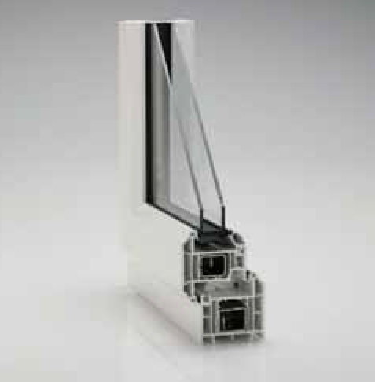
Rehau Total 70
70mm Frame depth back to front
Internally glazed casement
28mm or 36mm single leg bead, sculptured or flat
Fully featured grooves in all colours
Designed to accept the latest hardware innovations
Co-extruded black low line gaskets
Many standard foil colours
Galvanised steel reinforcement to British Standards
PAS24 (optional), BS7412, BS7950 on products
Window Energy Ratings – A, B, & C on all products
Concealed or face fix gearing on Tilt & Turn windows
Astragal Bar option in all colours
Run through sash horns in all colours
2
Notes:
Single Column Page

Slide 3
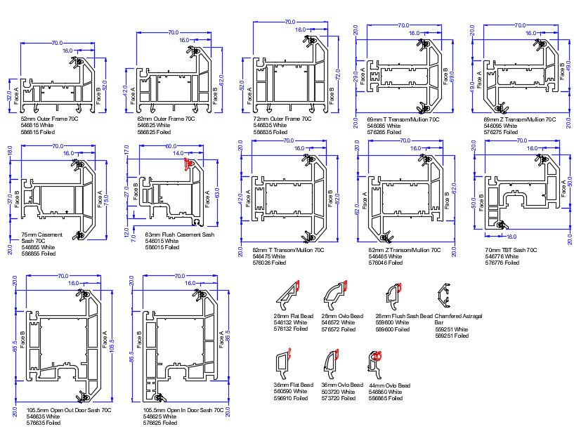
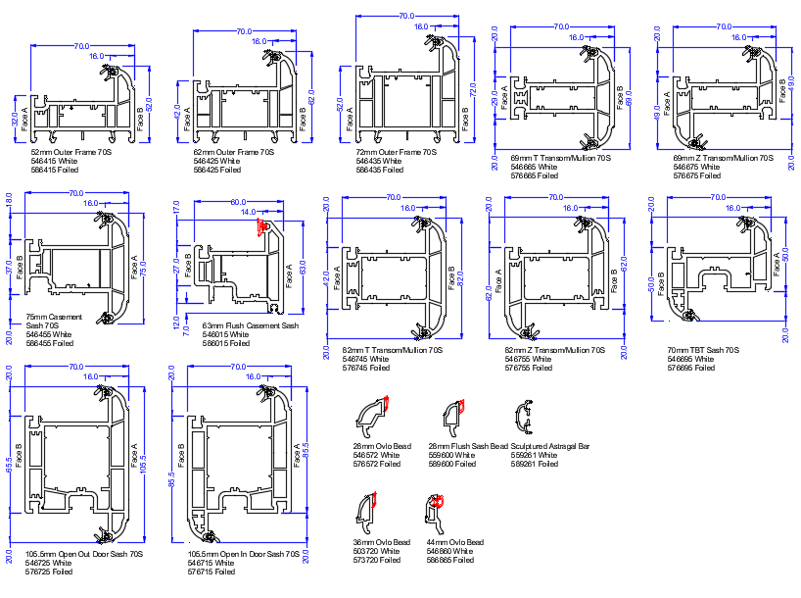

Profile Charts
70C Chamfered
70S Scupltured
3
Notes:
Single Column Page

Slide 4
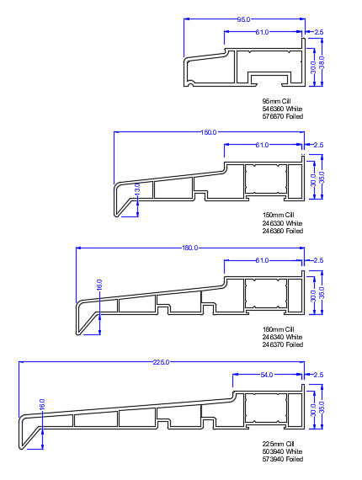
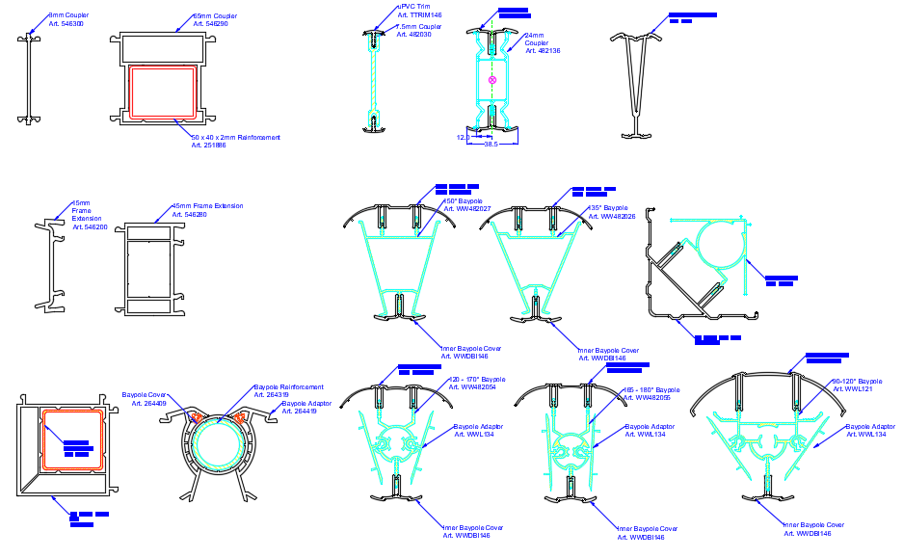
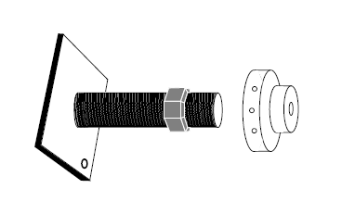
Profile Charts
Ancillaries, Frame Extenders, Baypoles, and Couplers
Jacking kits available
3
Notes:
Single Column Page

Slide 5
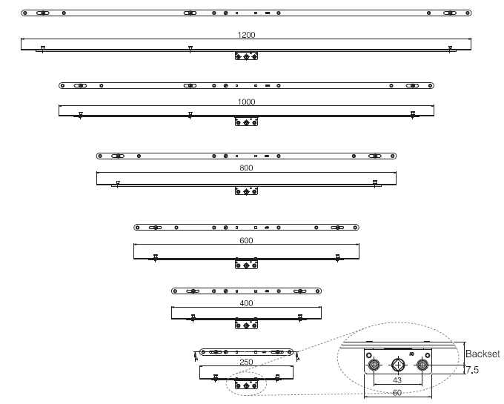
Casement Windows
Espagnollette Locking System
Mila iDeal Mushroom Espagnollette
2 or 3 locking points dependent on size
3
Notes:
Single Column Page

Slide 6
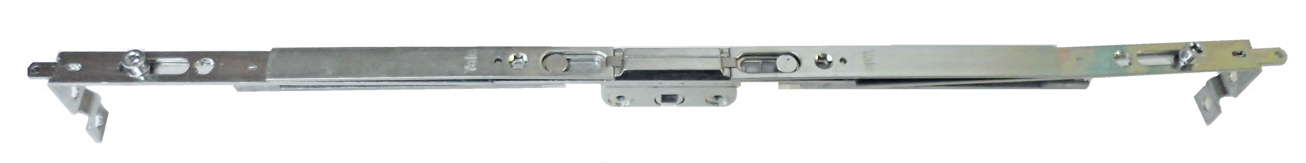
Casement Windows
Shootbolt Locking System
Yale Shootbolt Locking
2-4 Mushroom Locking Points depending on size and Corner Shootbolt Locking
BS EN 1670 Anti-corrosion performance
PAS24 Compliant
Secured by Design accredited
Shootbolt locking points
Mushroom locking points
3
Notes:
Single Column Page

Slide 7
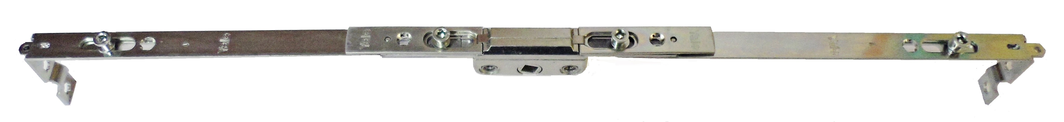
Casement Windows
Central Locking System
Yale Central Locking
4-6 Mushroom Locking Points depending on size, Corner Shootbolt Locking, & Central Mushroom Locking Points
BS EN 1670 Anti-corrosion performance
PAS24 Compliant
Secured by Design accredited
Shootbolt locking points
Mushroom locking points
3
Notes:
Single Column Page

Slide 8
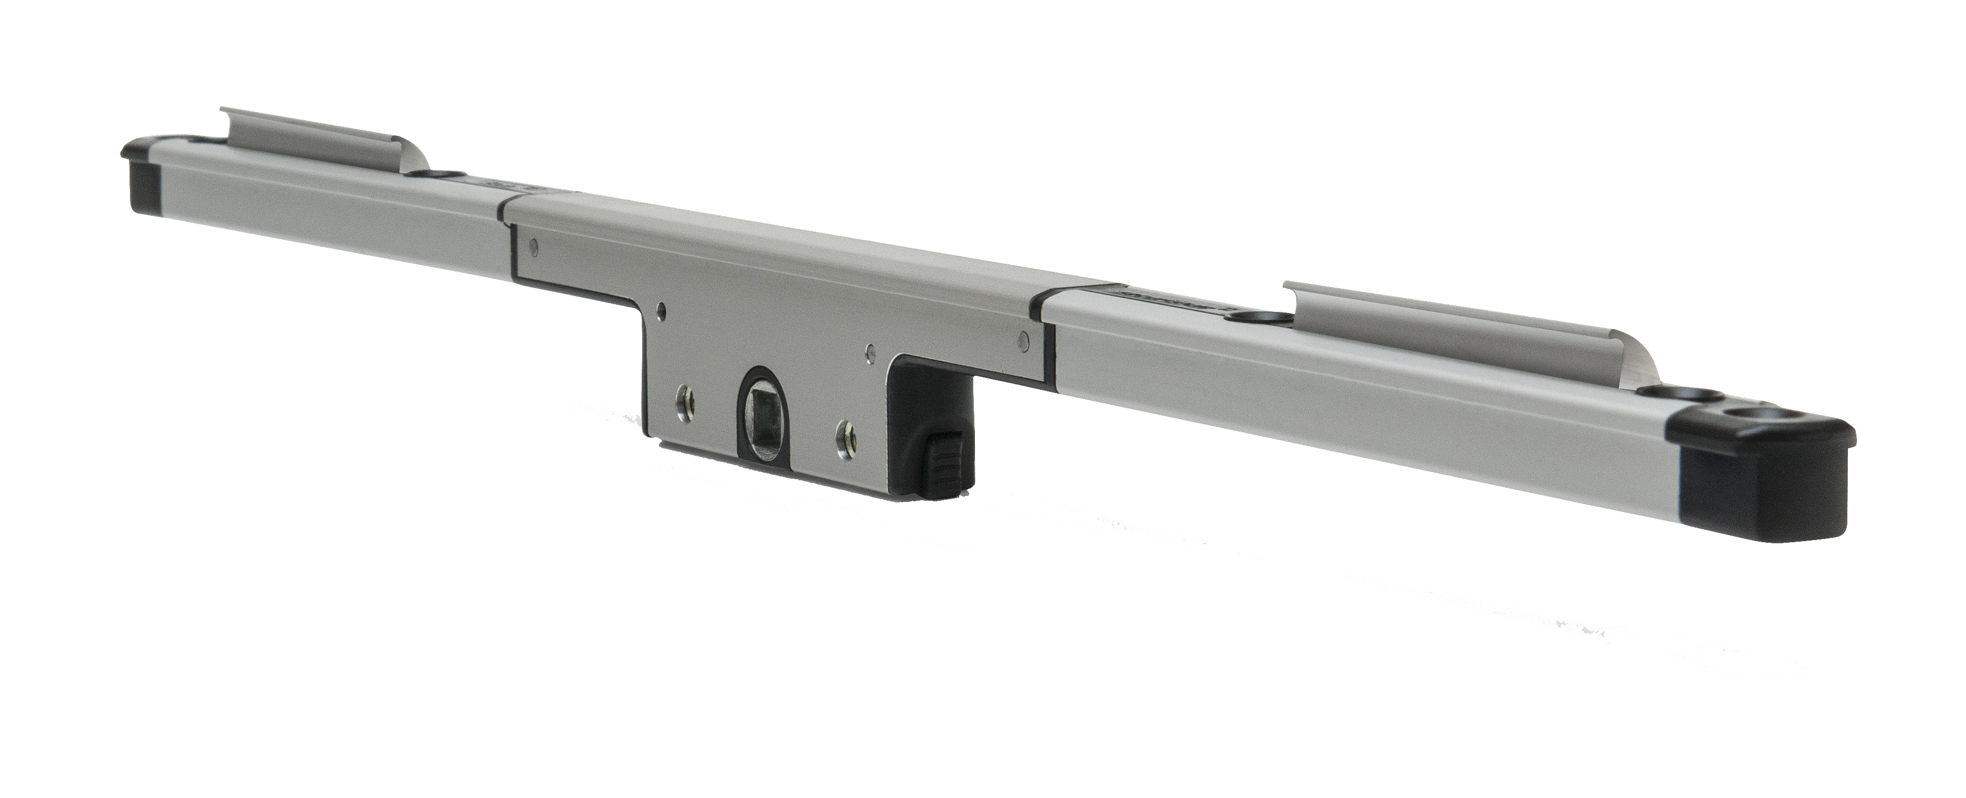
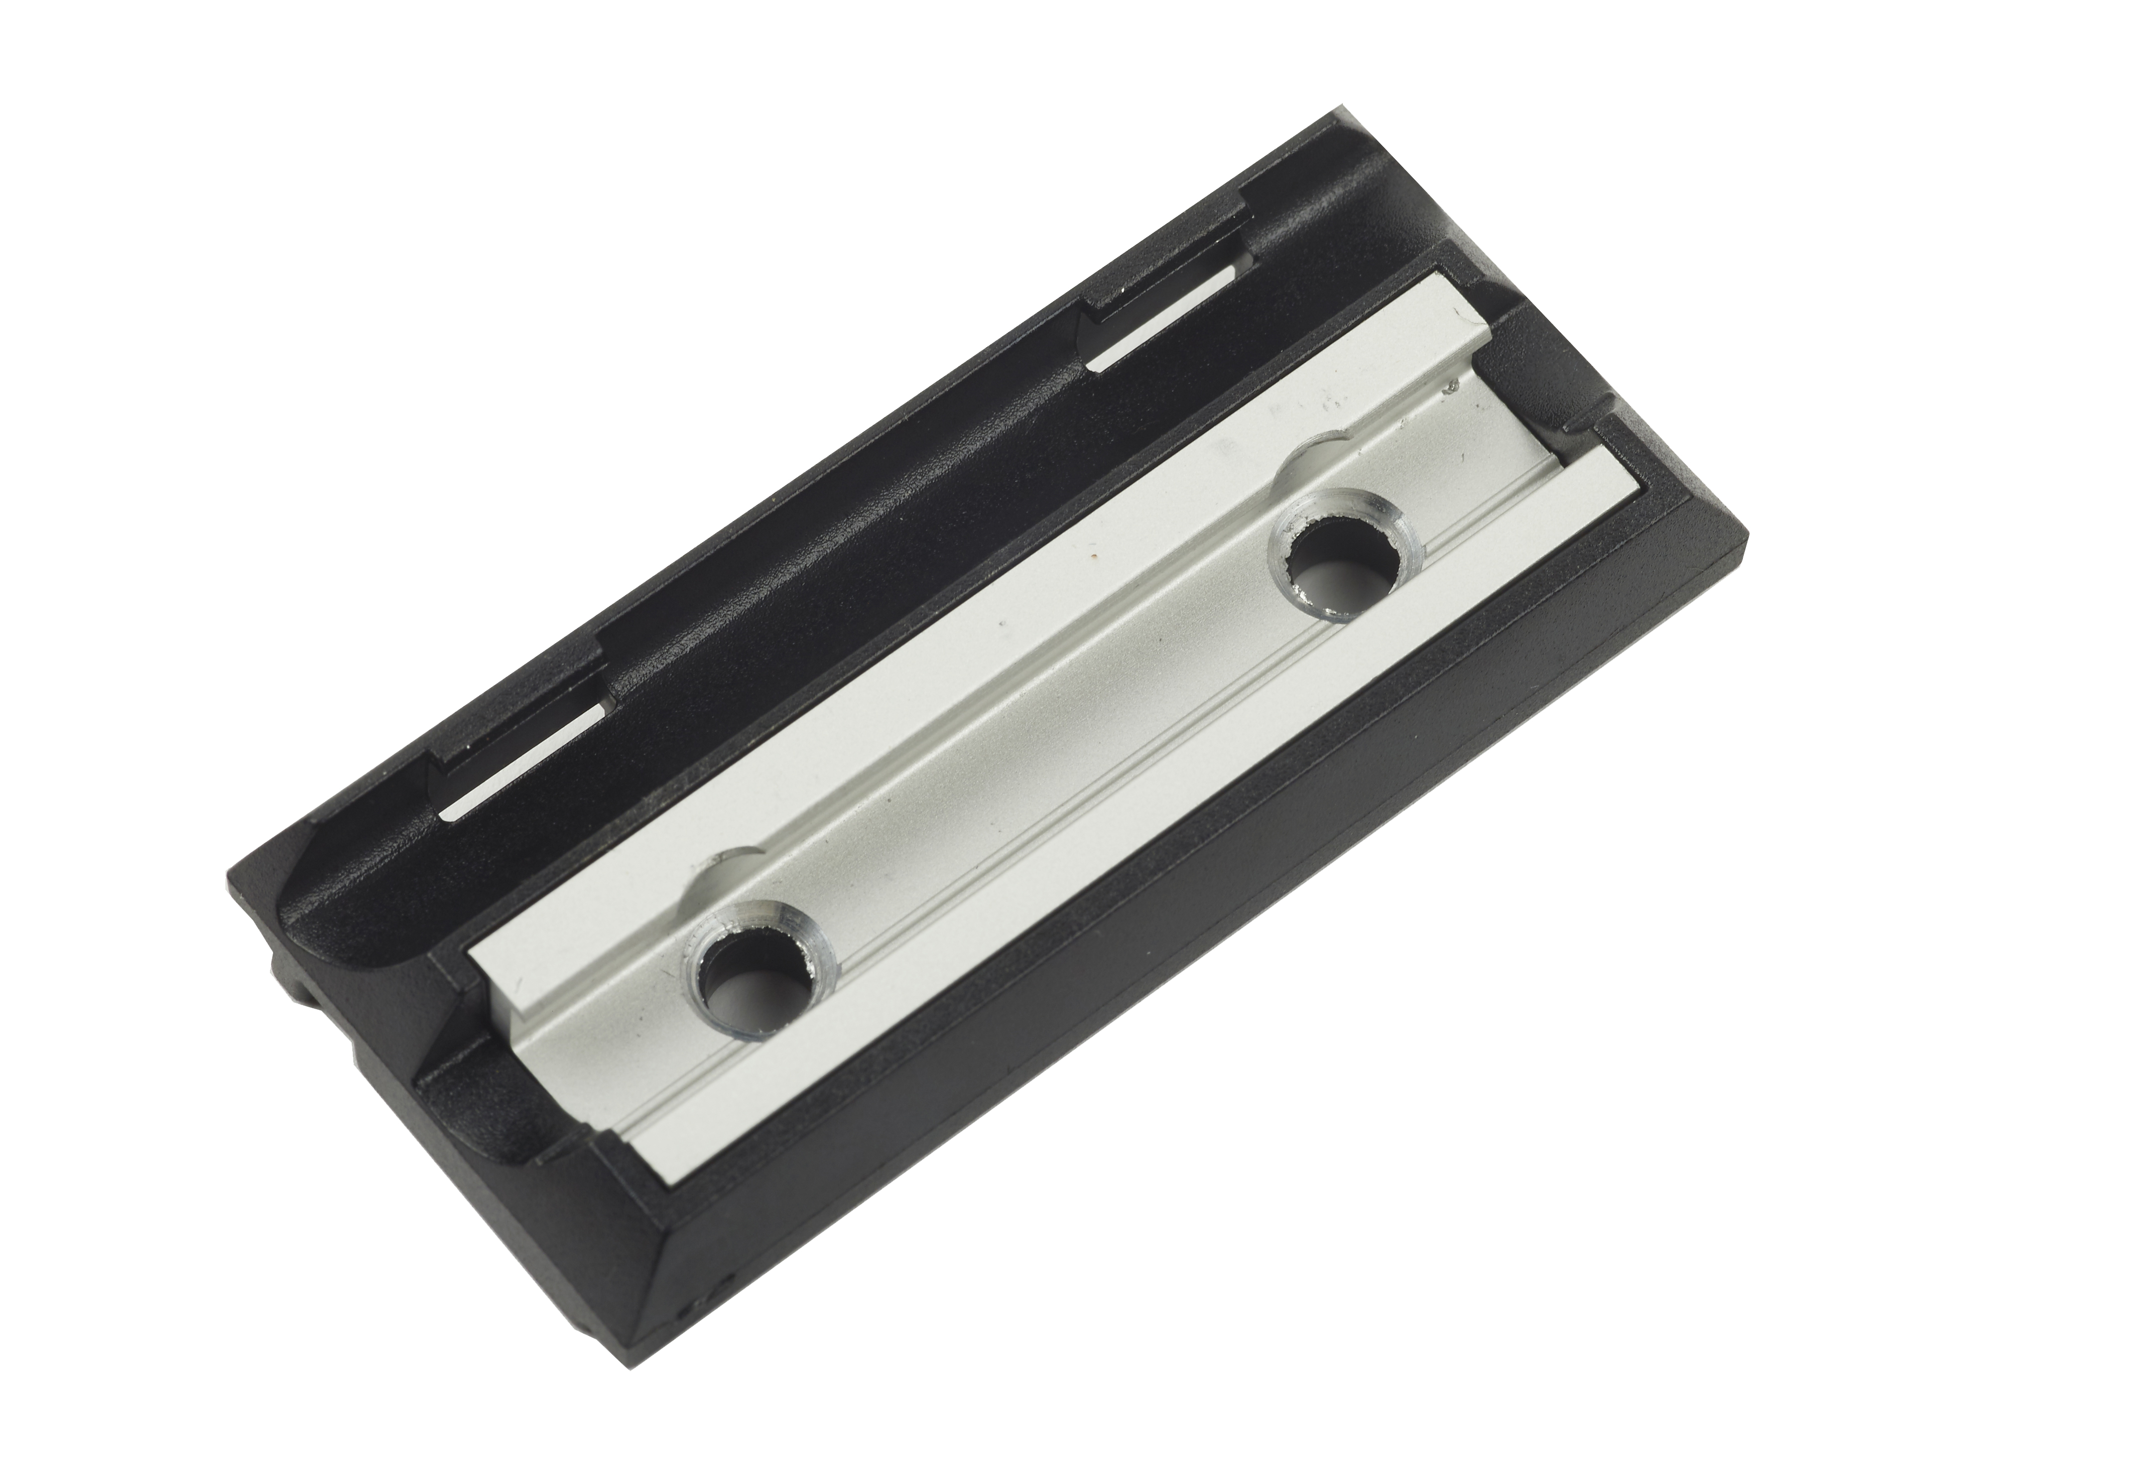
Casement Windows
Rapide Locking System
Yale Rapide Locking
2-3 Blade Locking Points depending on size
BS EN 1670 Anti-corrosion performance
PAS24 Compliant
Secured by Design accredited
3
Notes:
Single Column Page

Slide 9
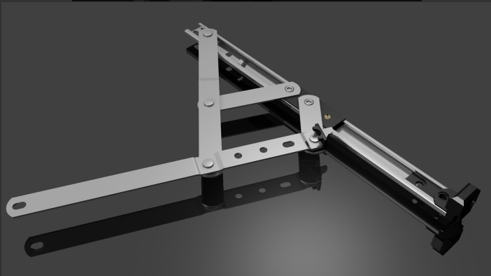
Casement Windows
Yale Friction Stays
BS 6375 Parts 1 and 2 for window performance
BS 6375-1:2015 classification for weather tightness
BS 6375-2:2009 classification for operation and strength characteristics
BS EN 1191 operation cycling testing
BS EN 1670 Grade 3 anti-corrosion resistance
Secured by Design compliant when fitted with Yale ancillary security devices
3
Notes:
Single Column Page

Slide 10
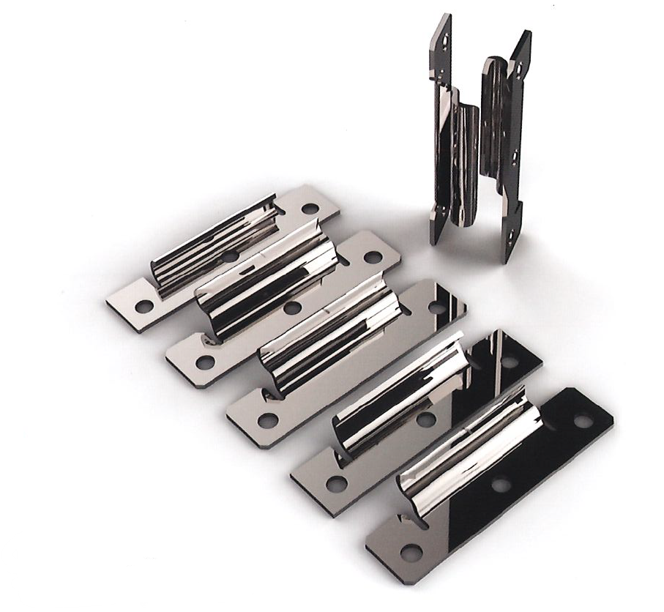
Casement Windows
GT/Yale Stay Guards
PAS24 Compliant
Secured by Design compliant when fitted with Yale ancillary security devices
3
Notes:
Single Column Page

Slide 11
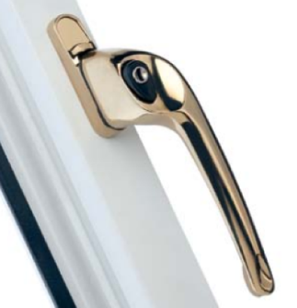
Casement Windows
Era Maxim 3 Handle
Zinc alloy casting to BS EN 12844:1999
Aluminium casting to BS EN 1676:1997
BS EN 1670 Grade 3 anti-corrosion resistance
Tested in excess of 10,000 cycles
Electroplated to BS EN 12540:2000
3
Notes:
Single Column Page

Slide 12
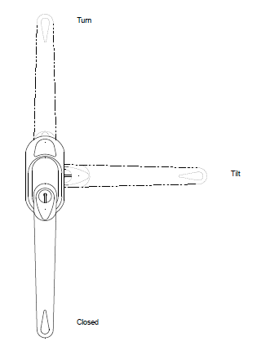
Tilt & Turn Windows
Tilt & Turn Windows have two open positions
3
Notes:
Single Column Page

Slide 13
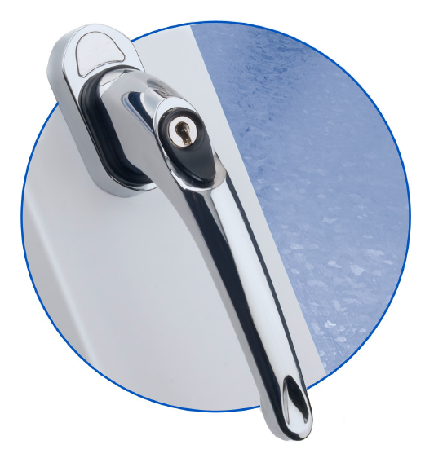
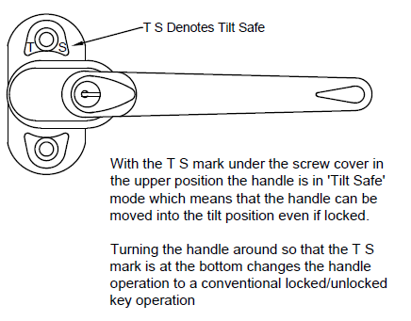
Tilt & Turn Windows
Era Maxim ‘Tilt Safe’ Handle
Zinc alloy casting to BS EN 12844:1999
Aluminium casting to BS EN 1676:1997
BS EN 1670 Grade 3 anti-corrosion resistance
Tested in excess of 25,000 cycles
Electroplated to BS EN 12540:2000
3
Notes:
Single Column Page

Slide 14
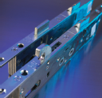

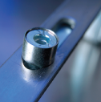
Residential & French Doors
Locking Systems
Yale 3 Hook, 2 Roller Lock
Multi Point Latch Lock with Hooks and Rollers
BS EN 1670:2007 Grade 4 (240 hrs NSST)
PAS24:2016 Security test
Secured by Design accredited
Tested to a minimum of 100,000 cylcles
Shootbolt option available
3
Notes:
Single Column Page

Slide 15
Residential & French Doors
Locking Systems
Yale 4 Roller Lock
Generally only used on doors too small for the 2 Hook, 2 Roller Lock
Can be used on doors too small for the 3 Hook, 2 Roller Lock
Multi Point Latch Lock with Rollers
BS EN 1670:2007 Grade 4 (240 hrs NSST)
Tested to a minimum of 100,000 cylcles
3
Notes:
Single Column Page

Slide 16
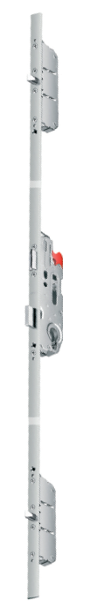
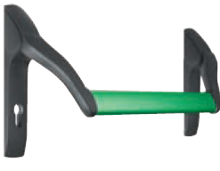
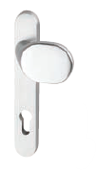
Residential Doors
Locking Systems
Fuhr Panic Bar Lock
Key operated lock with optional fixed knob handle for external access
EN179 for non-public buildings (Emergency Exit)
EN1125 for public building (Panic Exit)
3
Notes:
Single Column Page

Slide 17
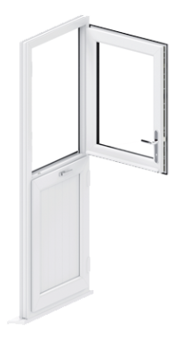
Residential Doors
Locking Systems
Fuhr Stable Doors
A locking system that allows the top half of the door to open independently
3
Notes:
Single Column Page

Slide 18
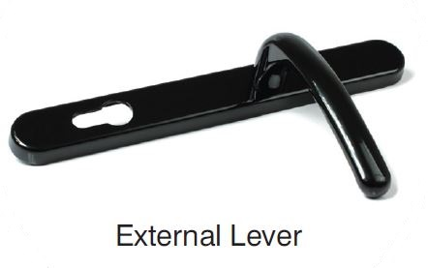
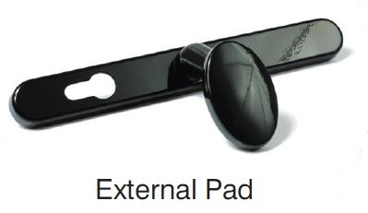
Residential & French Doors
Locking System Handles
Fab n Fix Ashford/Balmoral Handles
Solid die cast zinc construction
Available as Lever/Lever (External Handle) or Lever/Pad (Non functional External Pad)
92 PZ
BS EN 1670: Class 5, Salt spray tested to 480 hours
PAS24 accredited
Tested to a minimum of 200,000 cycles
3
Notes:
Single Column Page

Slide 19
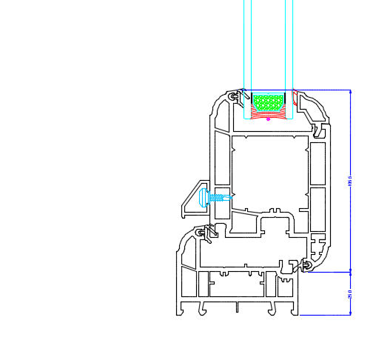
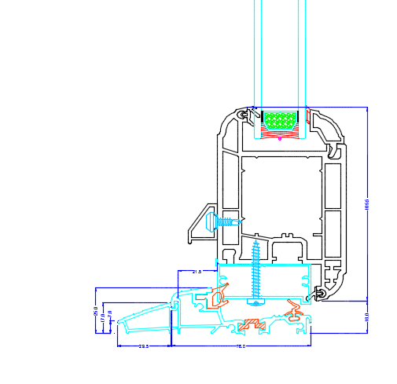
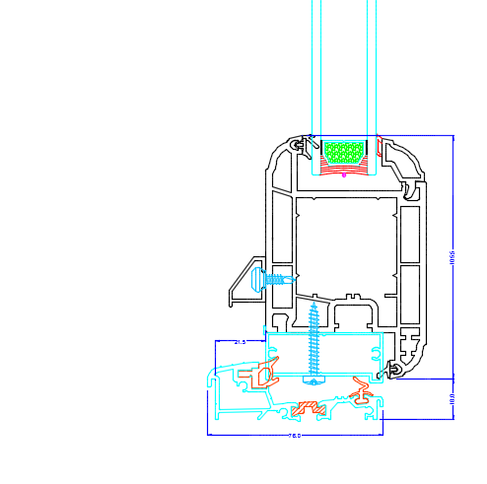
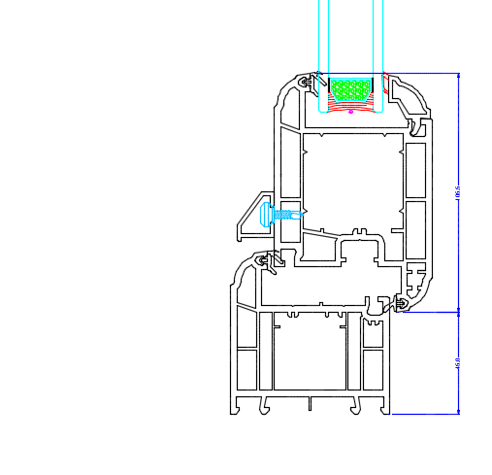
Residential Doors
Thresholds
Standard/Low PVCu
Standard, like the Outer Frame this uses the 72mm Profile, but can also use the 62mm or the popular 52mm
Exitex Low Aluminium
At 25mm is very slim but with the optional ramp added allows wheelchair access. The infill bar fitted to the underside of the sash gives a good weather seal to the threshold gasket
The optional ramp cannot be used with a cill however it is okay to use on an open out with a cill providing it can sit on a flat surface
3
Notes:
Single Column Page

Slide 20

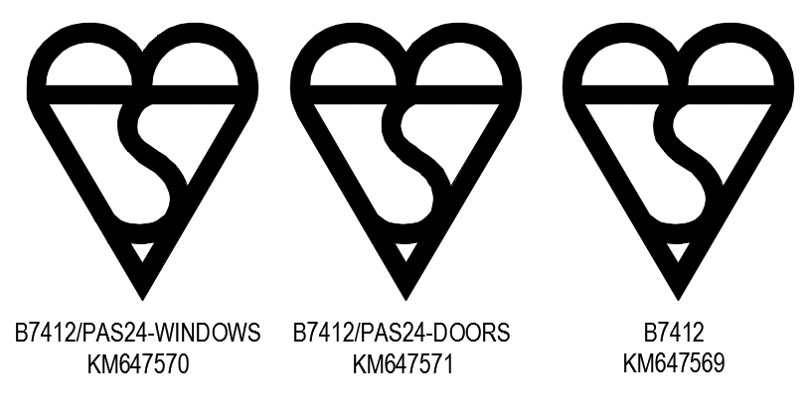

PAS24 Compliance
Secured by Design
Enhanced security is available on the majority of our range
Casement Windows
Shootbolt, Central Locking, or Rapide Locking, Stay Guards, and Glazing clips
Tilt & Turn Windows
Specific PAS24 Compliant Gearing, and Glazing clips
Residential & French Doors
2 Hook, 2 Roller Lock, specific PAS24 Compliant Shootbolts (French Doors) 1 Star rated Cylinders, and Glazing clips
3
Notes:
Single Column Page

Slide 21










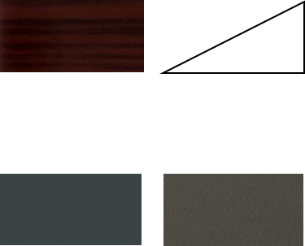

Profile Colours
Foiled and Sprayed
70C Chamfered Profile
70S Sculptured Profile
Woodgrain Foils (Both Sides)
Woodgrain Foils (Both Sides)
Golden Oak
Rosewood
Anthracite Smooth
Rosewood
Golden Oak
White Grain
Cream Grain
Anthracite
Woodgrain Foils (External On White)
Woodgrain Foils (External On White)
Mahogany
Rosewood
Golden Oak
Rosewood
Golden Oak
Black
Anthracite Grey
Cream
Smooth Foils (External on White)
Sprayed Profile
Anthracite
Slate Grey
In our Paint Shop we can spray profiles in virtually any colour, one side, both sides, foiled or smooth
3
Notes:
Single Column Page

Slide 22
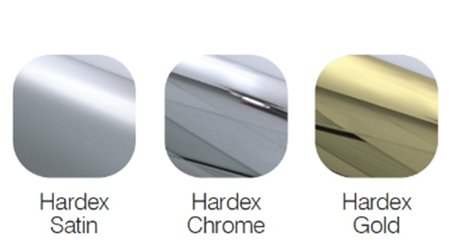
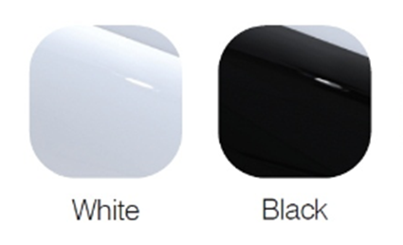
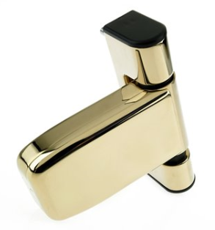
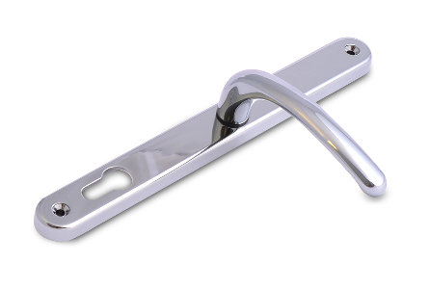
Hardware Colours
Handles, Hinges, Letterplates etc.
3
Notes:
Single Column Page

Slide 23
www.bespoketradeframes.co.uk
Units 1 & 2, Whittington Industrial Estate, Station Lane, New Whittington, Chesterfield, S43 2AF

